Slide 1
Investment Clock
Prof Rich Excell
Sharang Mantri

Slide 2
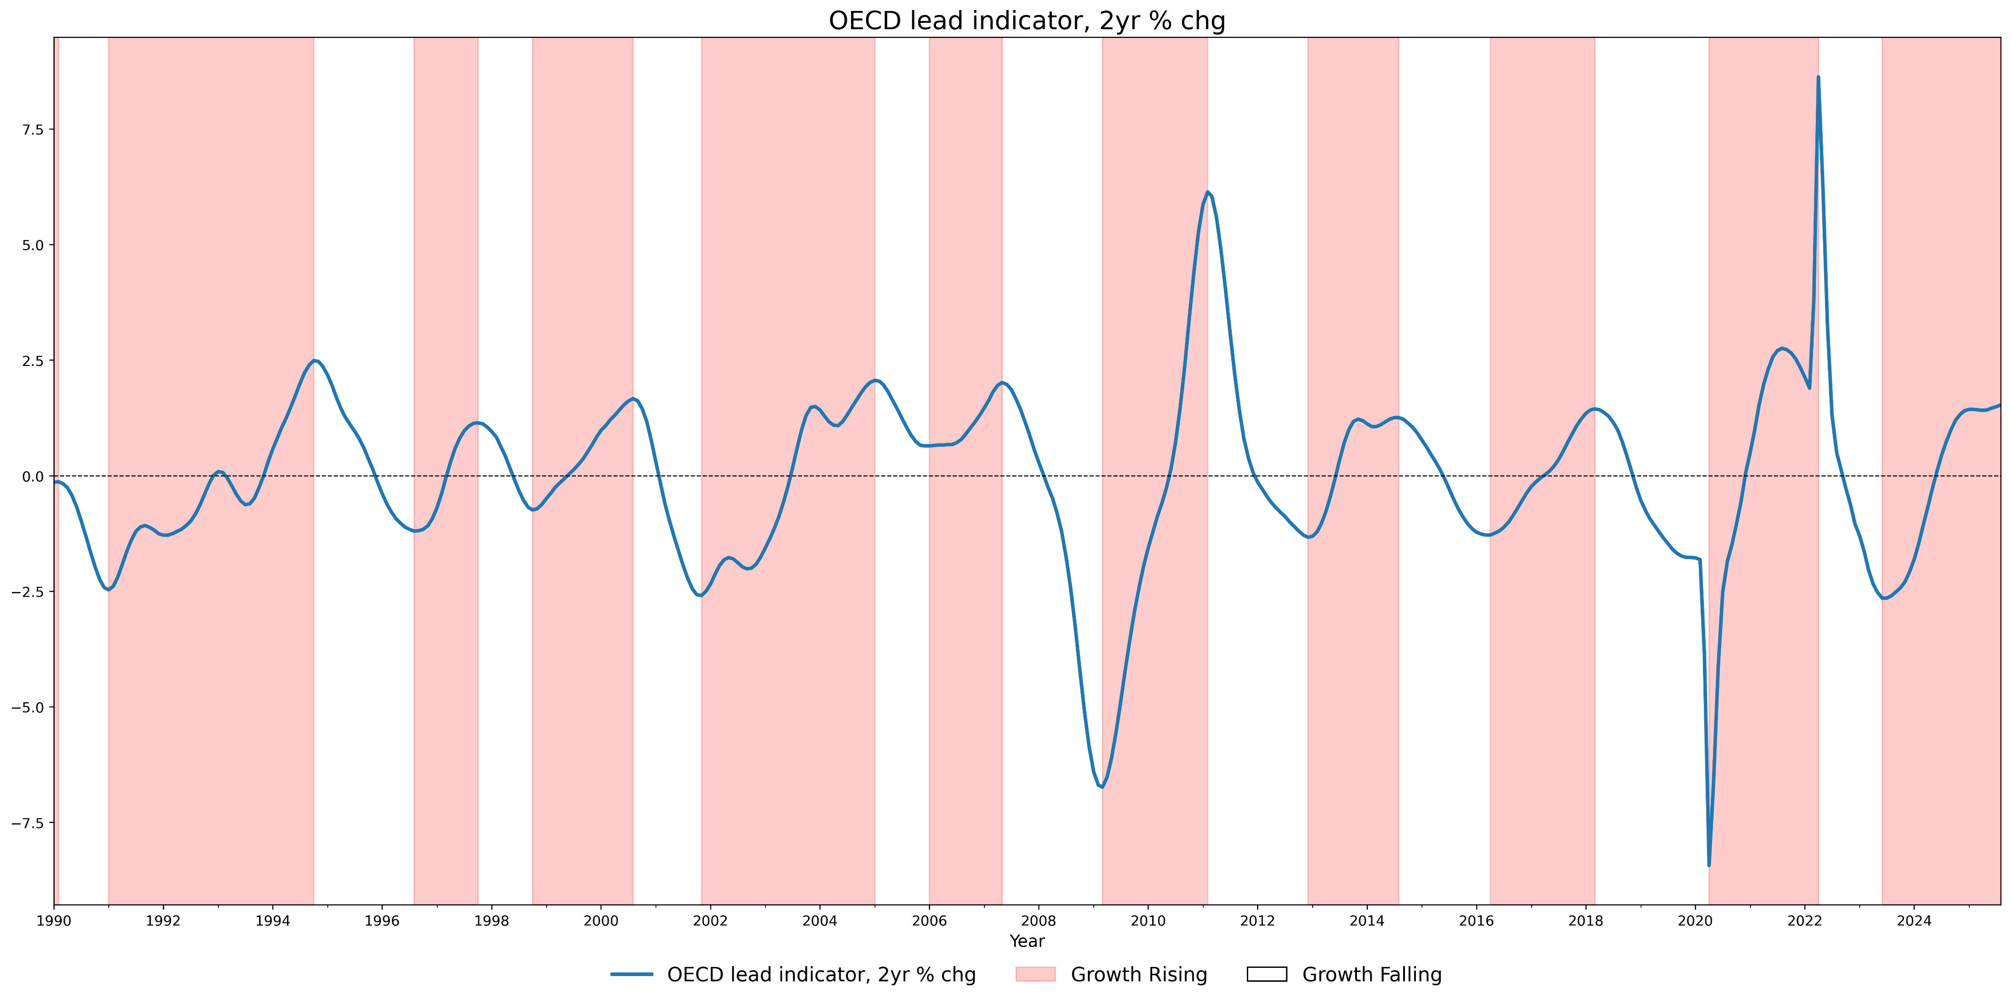
OECD Lead Indicator & Growth Signals

Slide 3
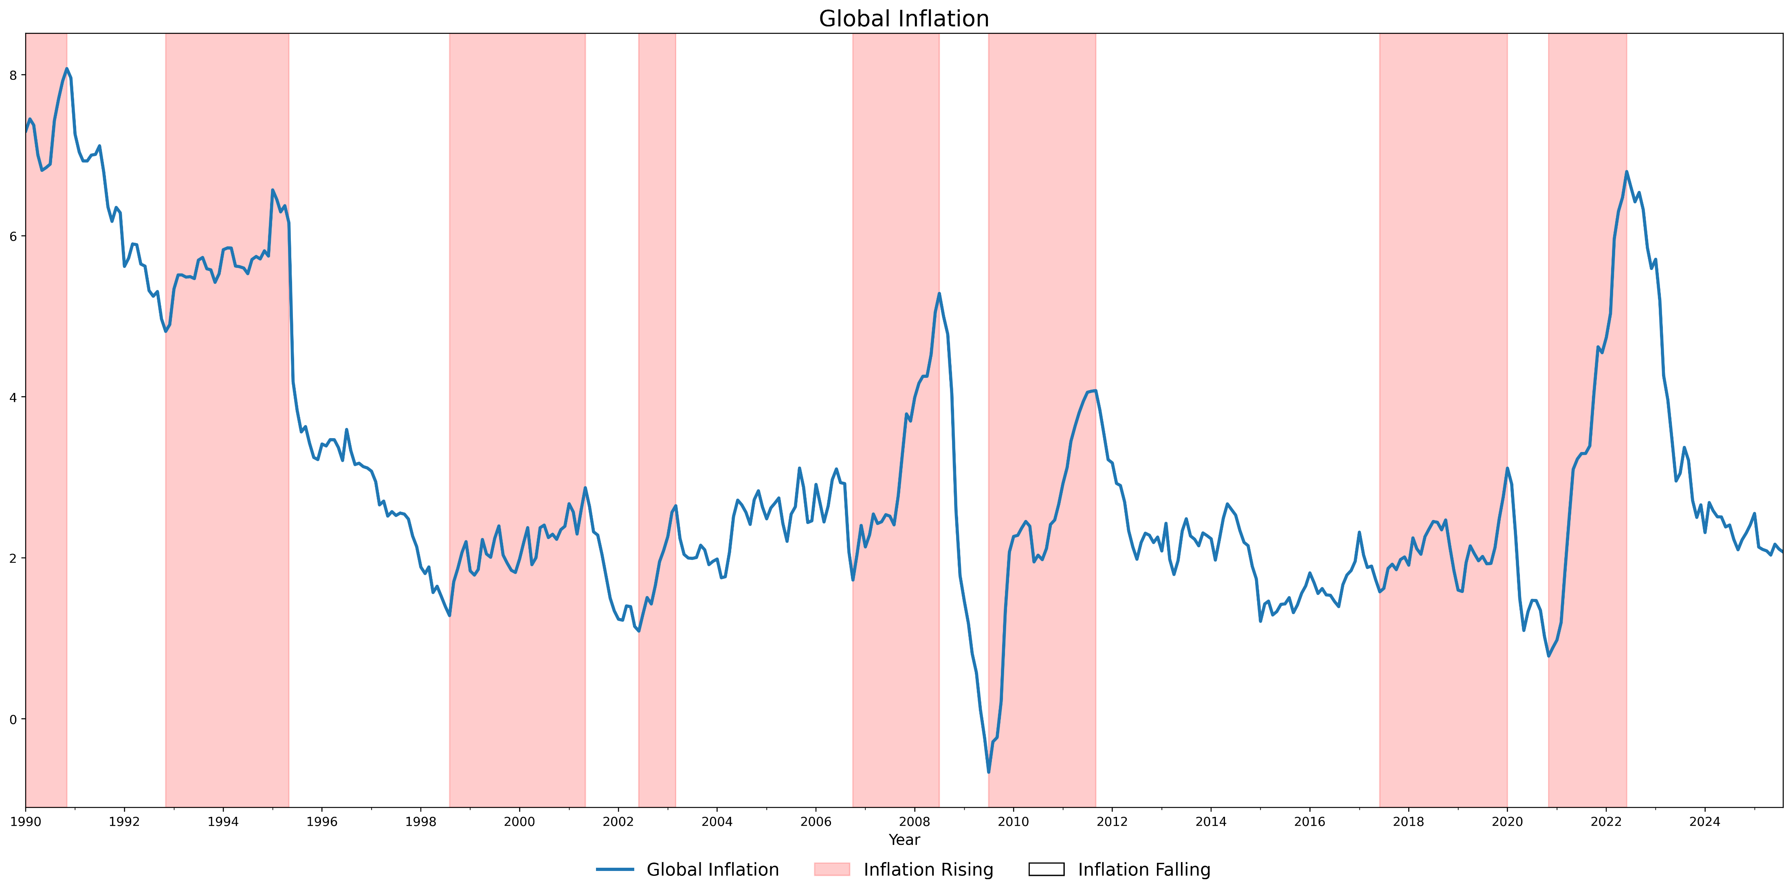
Global CPI Inflation & Inflation Signals

Slide 4
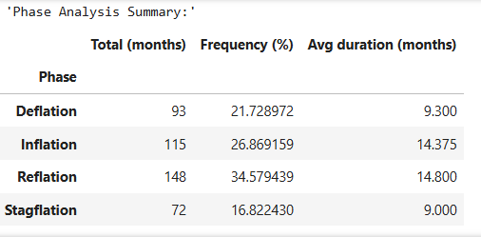
Investment Clock Phases from 1990
Reflation occurs double times than stagflation
Reflation & Inflation have the highest duration, as per expectations, given them being more desirable compared to other two phases
All four phases fairly represented as per expectation

Slide 5
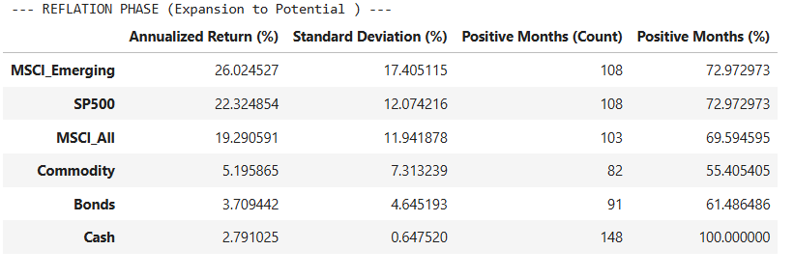
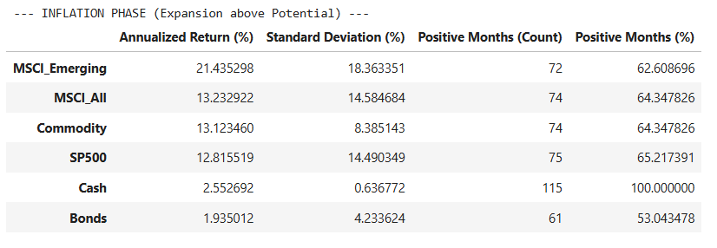
Asset class performance through the cycle
Equities best performer by a mile with a CAGR of 19%
Among equities emerging markets outperformed the overall equity market
SP500 also outperformed overall equity market
Equities and commodities best asset class with both providing a CAGR of 13%, though equities have a slightly higher volatility
Bonds & cash again worst performers, with bonds giving negative return in almost 50% of times monthly

Slide 6
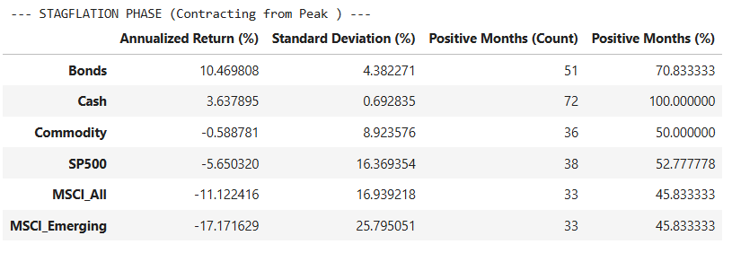
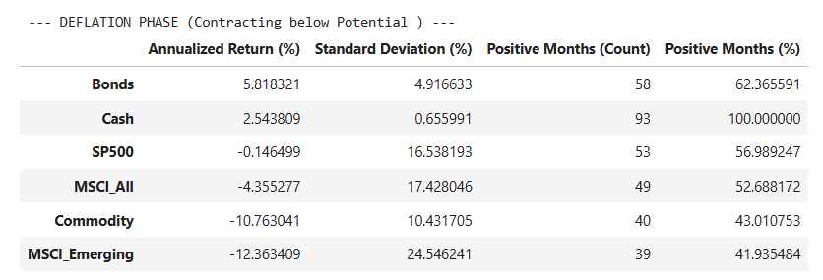
Asset class performance through the cycle
Bonds by far the highest performing asset class
Commodity unlike expectation gave flat return
Equities performed worst, giving positive return less than 50% times
Bonds again best asset class, though less return than stagflation
Commodities worst performer, along with emerging market equites
SP500 against expectations gave a flat return

Slide 7
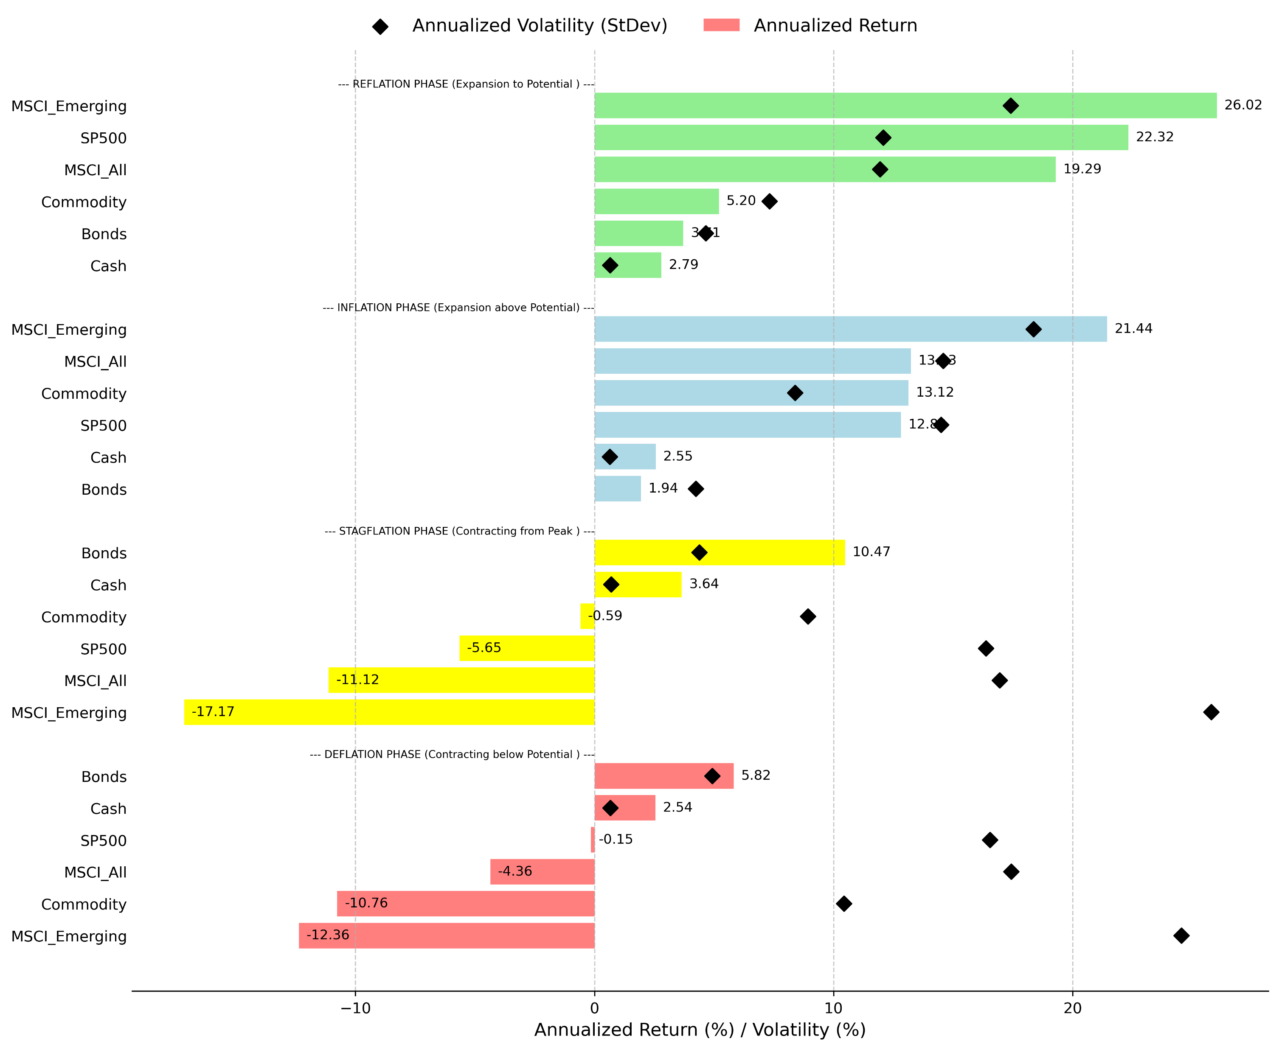

Slide 8
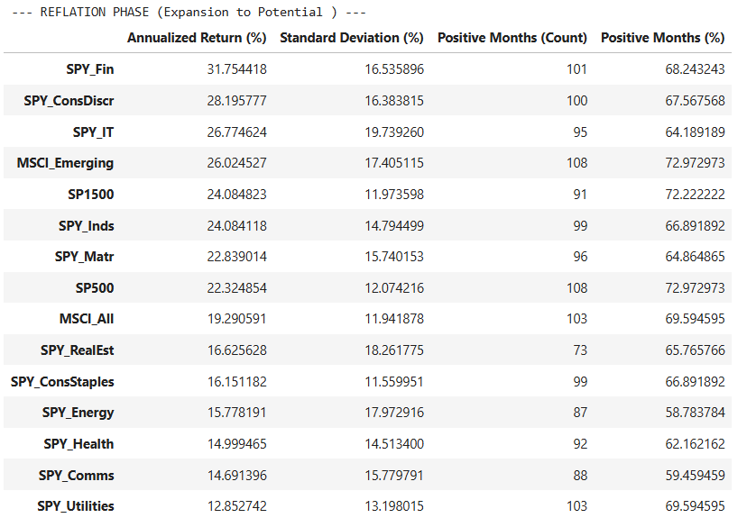
Global Equity Sector Performance through the Cycle
Finance, Consumer Discretionary, IT, Industrials, materials are the best performers
Utility, communication, Staples, Health, Energy are underperformer
Equity returns are highest in reflationary phase
SP500 & Sp1500 both outperformed MSCI global index
Finance, Cons Discre., IT even outperformed MSCI Emerging
All sectors gave positive return more than 50% of the times on monthly basis

Slide 9
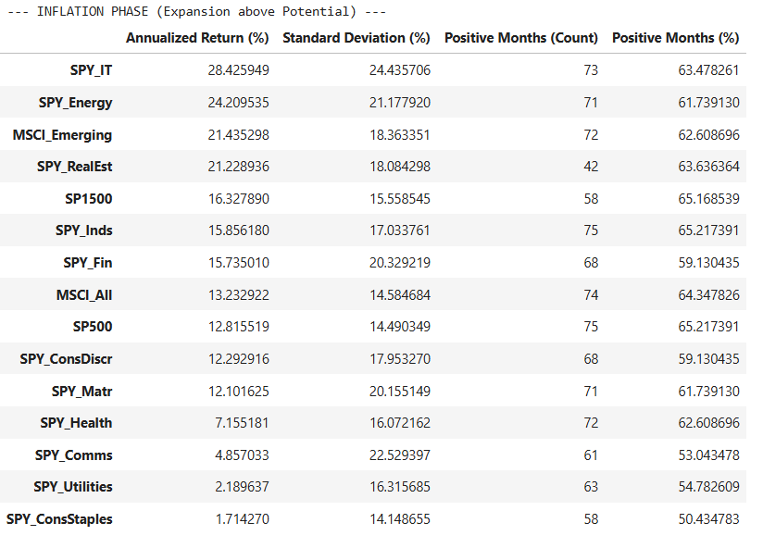
Global Equity Sector Performance through the Cycle
IT, Energy, Real Estate, Industrial best performing sectors
SP500 underperformed MSCI global index slightly
Equity returns of each sector still positive, with all sectors giving positive return atleast 50% of times on monthly basis
Against expectations Financials performed better than SP 500

Slide 10
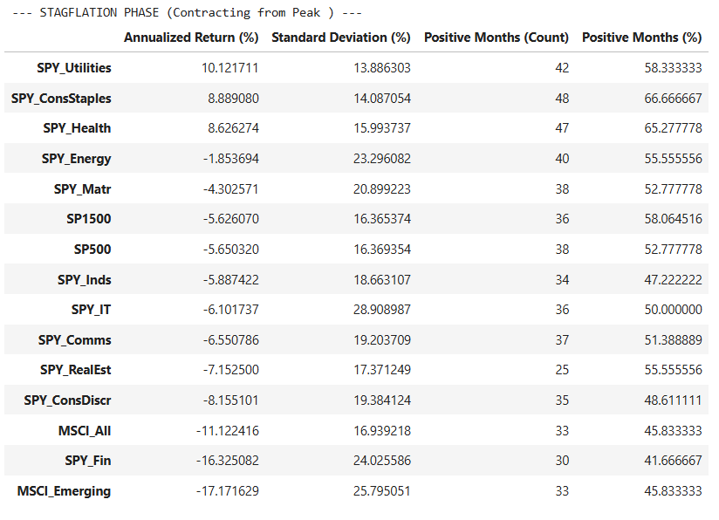
Global Equity Sector Performance through the Cycle
Equites performed worst during stagflation out of all four phases with return of -11%
Utilities, healthcare, and consumer staples were the only sector with positive return
SP500 & SP1500 gave negative return overall but on monthly basis gave positive return more than 50% of times
Volatility also increased compared to reflation and stagflation

Slide 11
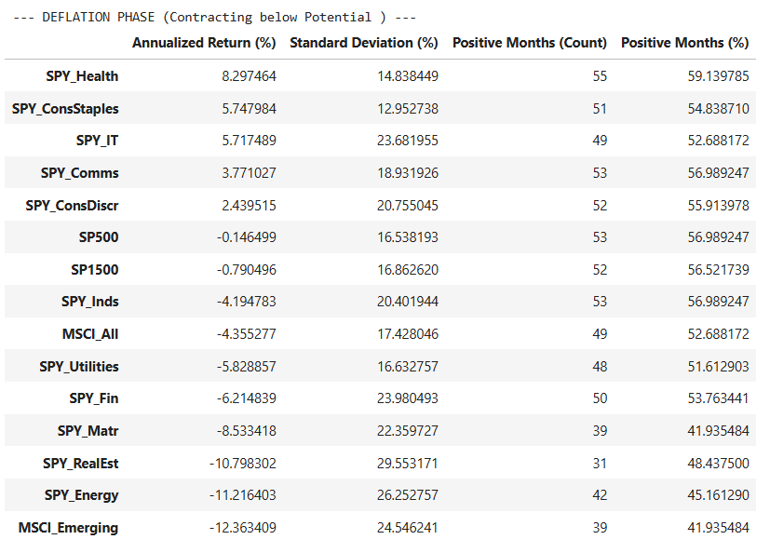
Global Equity Sector Performance through the Cycle
Equities again gave negative return, though better performance than stagflation
SP500 gave a flat return with positive monthly returns more than 50% of times
Healthcare, Staples, IT, Comms best performers
IT against expectations gave positive return
Energy, Real Estate, Materials were the worst performers with high volatility

Slide 12
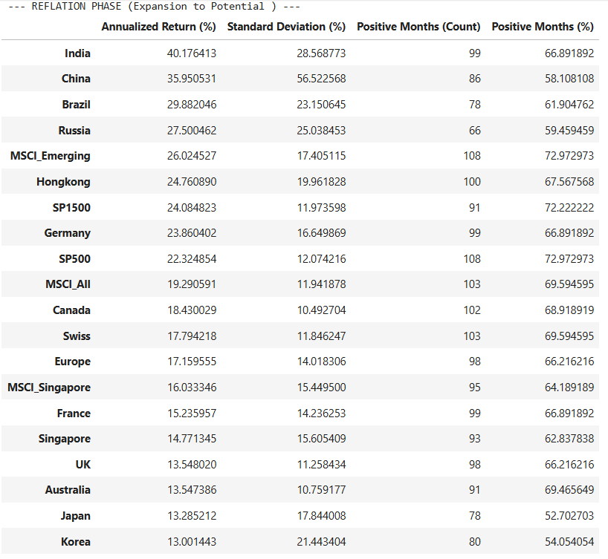
Global Equity Market Performance through the Cycle
BRIC nations are biggest outperformer during reflation, in which India tops with a CAGR of 40%
SP500 & SP1500 also outperformed MSCI global index
Defensive markets like Japan, Korea are the biggest underperformers, including Europe
All countries gave +ve returns more than 50% of the time during the phase with SP500 & SP1500 leading the way

Slide 13
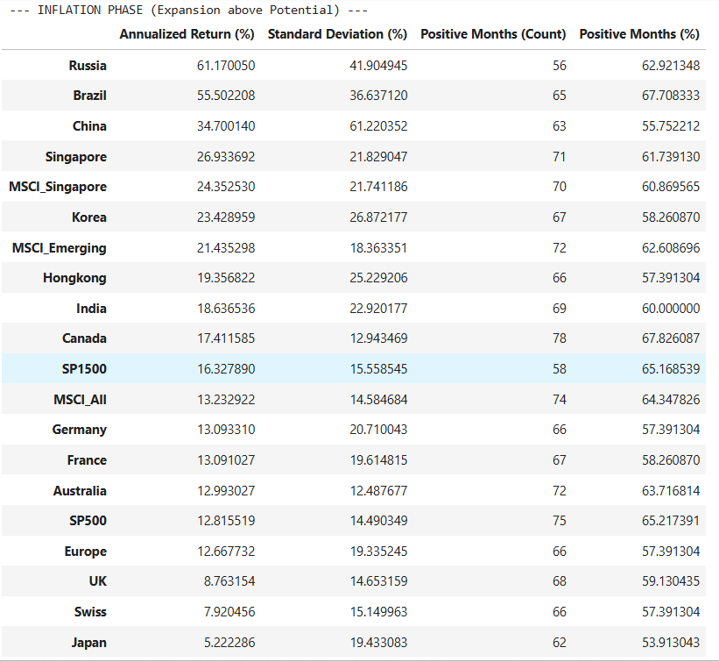
Global Equity Market Performance through the Cycle
Commodity exporter countries like Russia, Brazil have outperformed extensively though with a high volatility
Net importing countries underperformed, while every market gave positive return
Japan, Swiss, UK as defensive markets performed comparatively bad
SP500 underperformed MSCI global while SP1500 outperformed
All countries gave positive return more than 50% of times in the phase

Slide 14
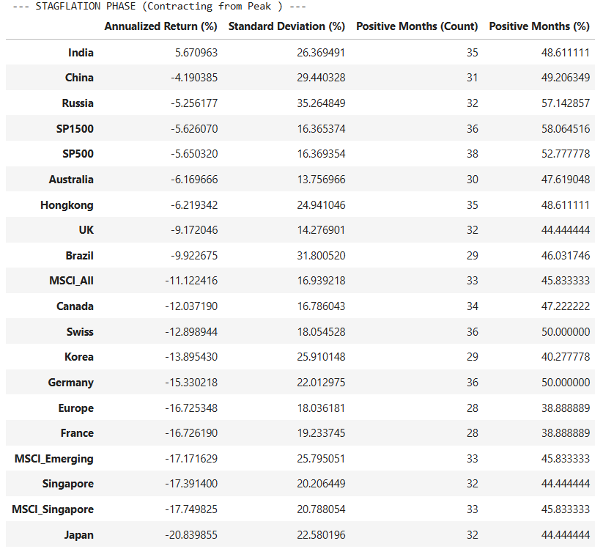
Global Equity Market Performance through the Cycle
All countries gave negative return except India during the stagflationary period against expectation
Japan, Emerging, Singapore, Europe being the worse performers of all
SP500 & SP1500 are the only two indices with positive returns more than 50% of the times in the phase
Every country saw an increased volatility, especially emerging markets

Slide 15
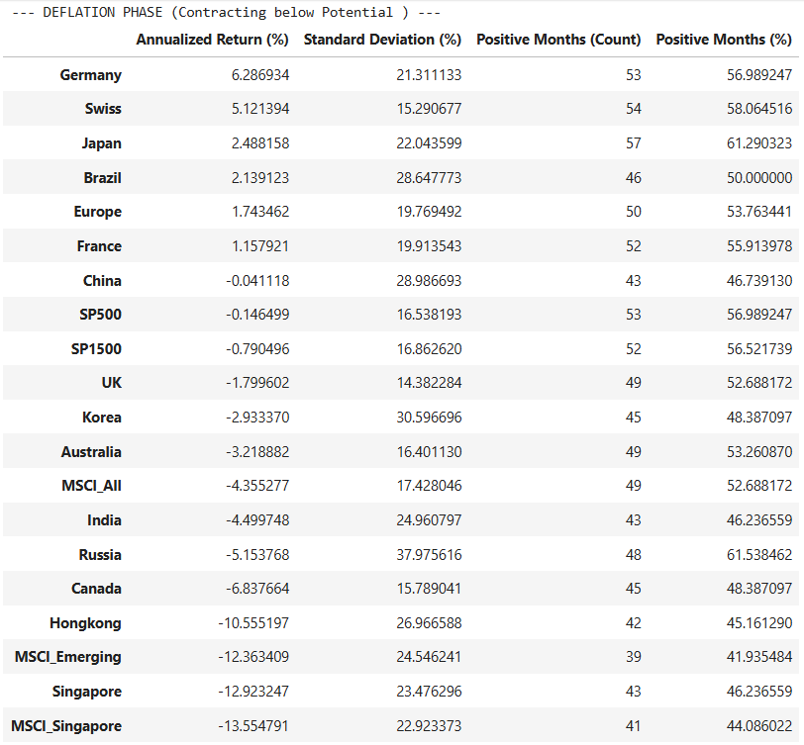
Global Equity Market Performance through the Cycle
German, Japan, Swiss, & Europe markets are the outperformers with their defensive strengths
SP500 & SP1500 both performed better than MSCI global albeit giving negative returns
Emerging markets are the worst performers

Slide 16
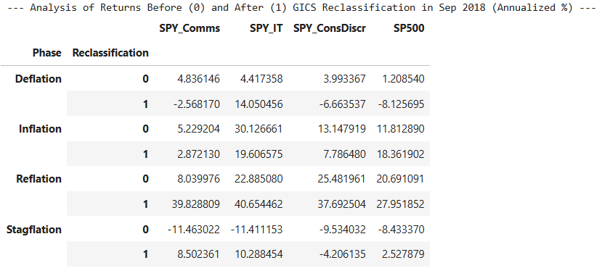
Effect of Company Reclassification
Meta & Google moved from IT to Comms; Disney & Netflix from Cons Discretionary to Comms in Sept 2018
This move has made comms outperformer compared to SP500 in all phases except inflationary
Comms also gave positive return in stagflation, going from underperforming SP500 to outperforming post change while their return became exceptionally well in reflationary period with same property wrt SP500
IT still maintains its attractiveness and market leading capacity most of the times

Slide 17
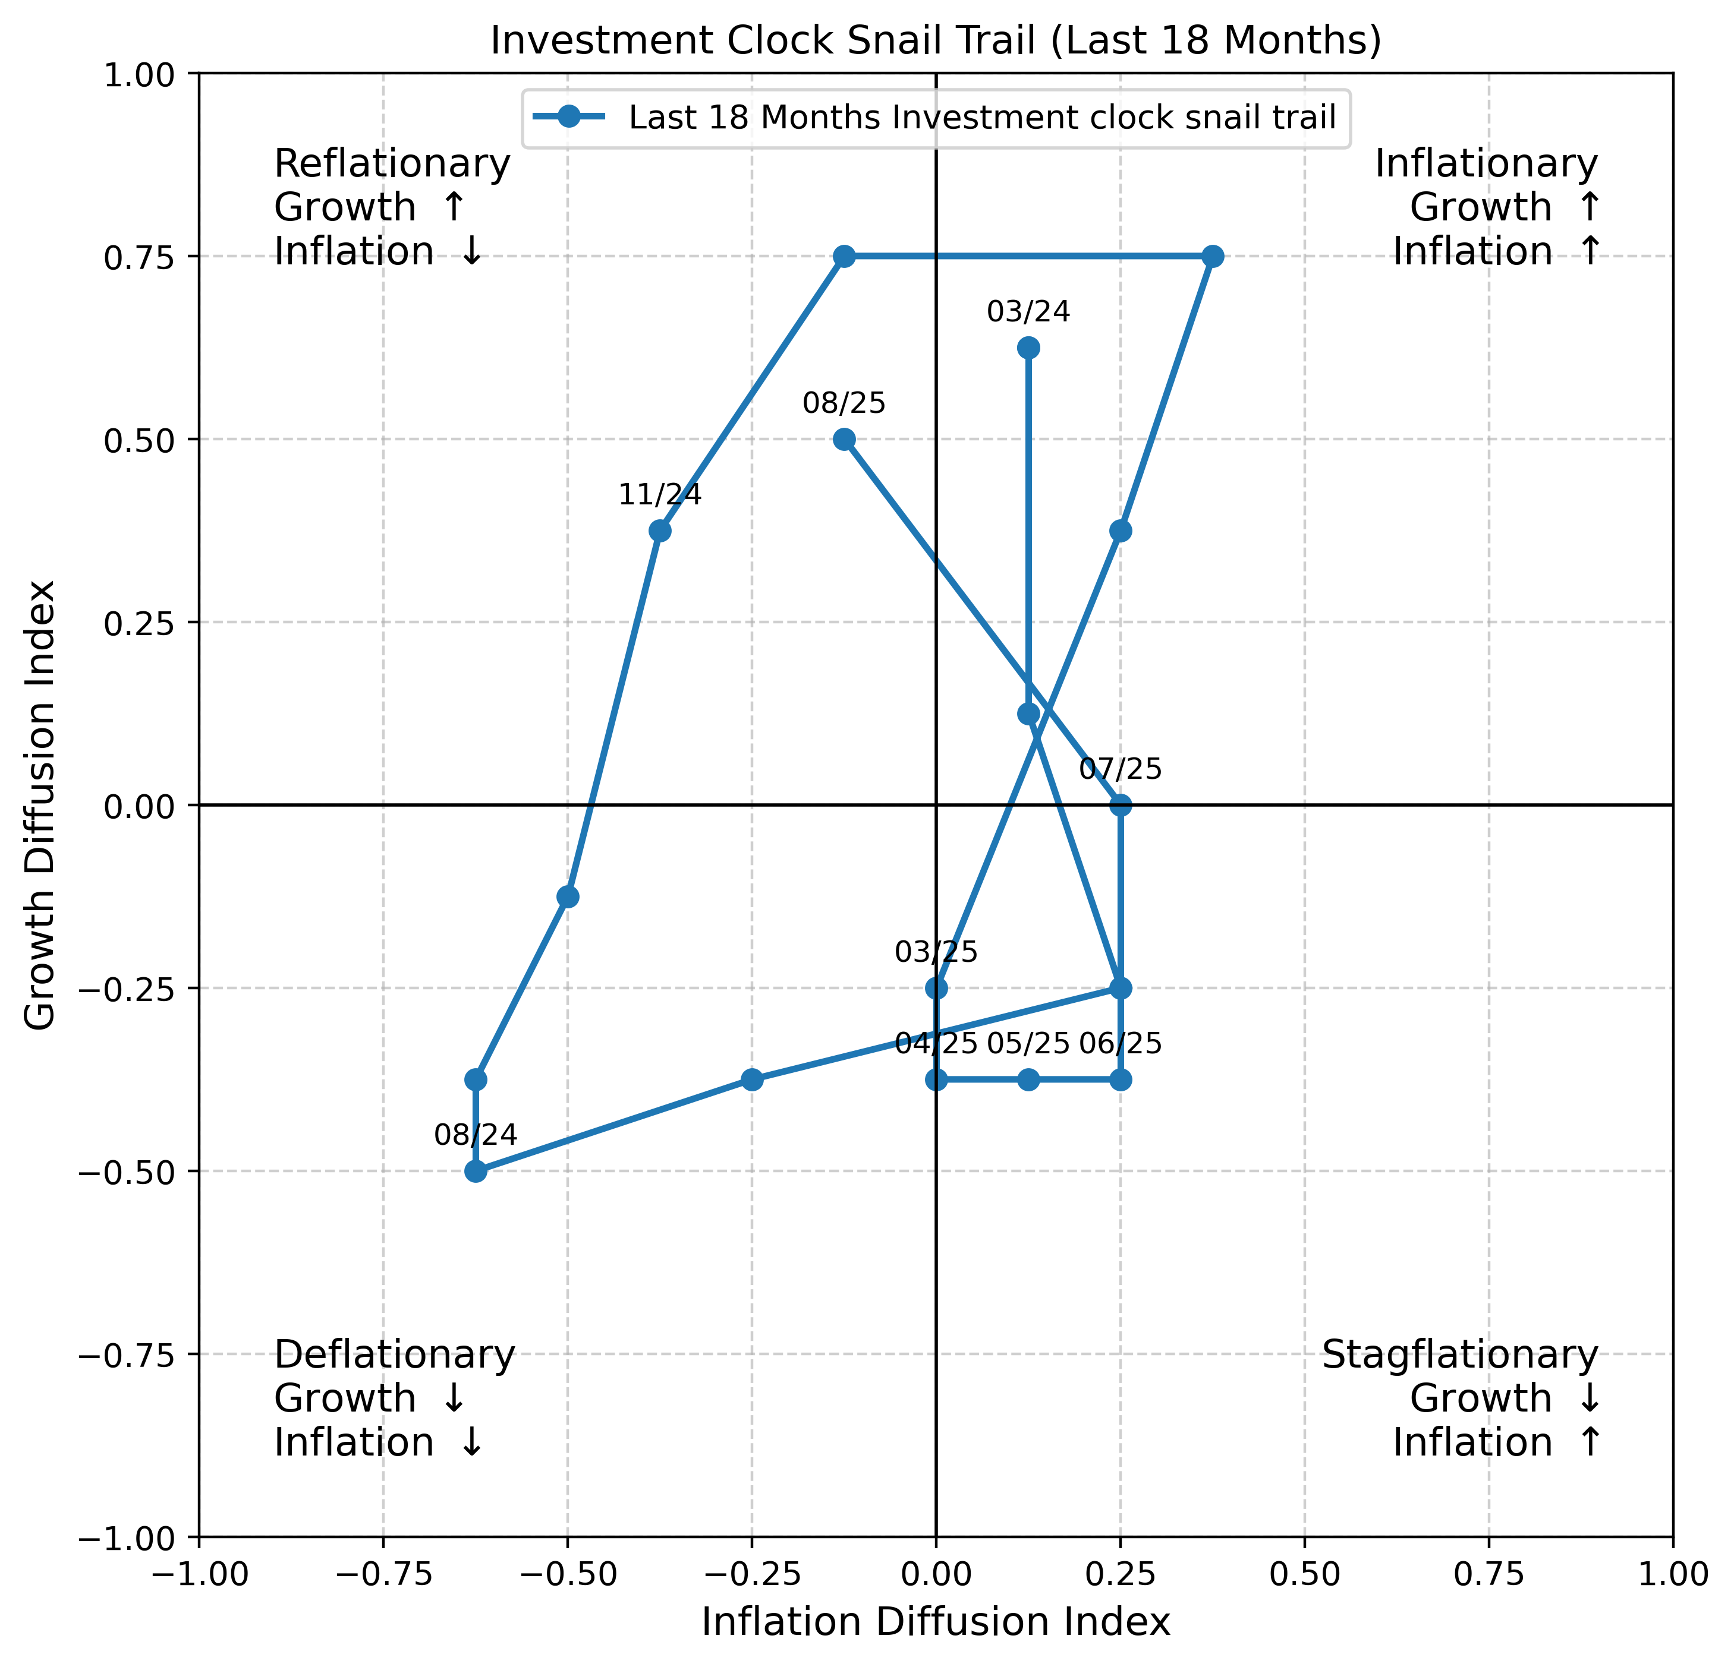
Growth: OECD G7, ISM New Orders, US Initial Jobless Claims, Consumer Confidence
Inflation: US-3M yield, PMI Price Paid, CRB Commodity index, Global CPI
Recent reading of growth inflation diffusion index show economy moved through all the phases in past 18 months
For past 5 months economy showed signs of stagflation with moving to reflation in August

Slide 18
Summary of Results
Reflation
Equities are best performing asset class, Finance, IT, Consumer Discretionary, Industrial are the best performers with BRIC and emerging market leading the way
SP500 & SP1500 also outperformed the global equity market
Defensive markets of Japan, Europe among worst performers with sectors like Utilities and Health underperforming
Inflation
Equities and commodities among equally best performers with commodity heavy export countries like Brazil, Russia best performer with IT, Energy, Real Estate, and emerging leading
SP1500 outperformed global index while SP500 gave almost save return as MSCI global
Japan, Swiss, UK among worse performing markets with sectors like Utilities, Health, Staples lagging market return
Finance

Slide 19
Summary of Results
Stagflation
Bonds are best asset class with equities giving negative return, commodities against expectations gave flat return with staples, health, utilities only positive sector and India only country giving positive return
SP500 & 1500 gave negative return but better than MSCI global
Emerging, Finance, Discretionary, Real Estate sectors with markets of Japan, Singapore, Europe worse performers
Deflation
Bonds best performing asset class, commodities being worst, health, staples, IT, Comms better performers, Germany, Swiss, Japan markets among best performing among a sluggish equity market
SP500 & SP1500 performed better than MSCI global giving flat negative return
Emerging, Energy, materials, Real Estate worse performing sector with markets of Singapore, Hongkong Canada, Russia being worst
Finance

Slide 20
Thank You

